Slide 1
Programmable Objects
Part 1

Slide 2
Programmable Objects in SQL server
Sql server allows you to create three types of programmable objects:
Stored Procedures
User Defined Functions
Triggers

Slide 3
Stored Procedures
Pre-compiled execution plan:
Sql server compiles each stored procedure once and then store compile and execution plans in query cache and reuse for subsequent executions. so you get tremendous performance boost when stored procedures are called repeatedly.
Abstraction:
Stored procedures provide an abstraction layer that shields applications from the underlying database structure.

Slide 4
Programmable Objects
Variables
Parameters
Control flow constructs (IF/Else, while, for loops)

Slide 5
Variables
Sql server provides two types of variables:
Local and Global
Local variable is instantiated with single @ sign while global variable is instantiated with double @@ sign.
Variables are declared with DECLARE clause where you specify name and data type of variable.
Either SET or SELECT is used to assign a value to a variable.

Slide 6
Example
DECLARE @var int
Set @var = 1
Select @var

Slide 7
Control flow constructs
If/else
Declare @var int
Set @var = 1
If @var = 1
Print ‘this is the code executed when true’
Else
Print ’this is the code executed when false’

Slide 8
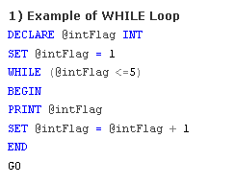
While loop

Slide 9
Parameters
Parameters are local variables that are used to pass values into a stored procedure when it is executed.
U can create two types of parameters:
Input and output
Output parameters are used when u need to return a single value to an application.

Slide 10
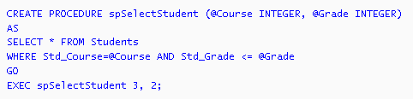
Input parameters example

Slide 11
Output parameter example
create procedure getmanagerID
@employeeID int, @managerID int output
AS
begin
select Manager
from Employee
where Empno = @employeeID
end
declare @var int
execute getmanagerID 12 , @managerID= @var output

Slide 12
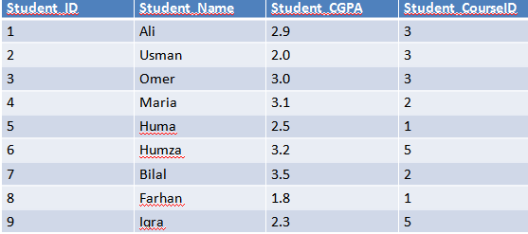
Class Activity
Create a stored procedure that takes name of the student as input and display the grades of that student with course code.
Output should like:
Course Name Grades

